Slide 1
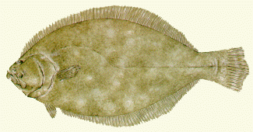
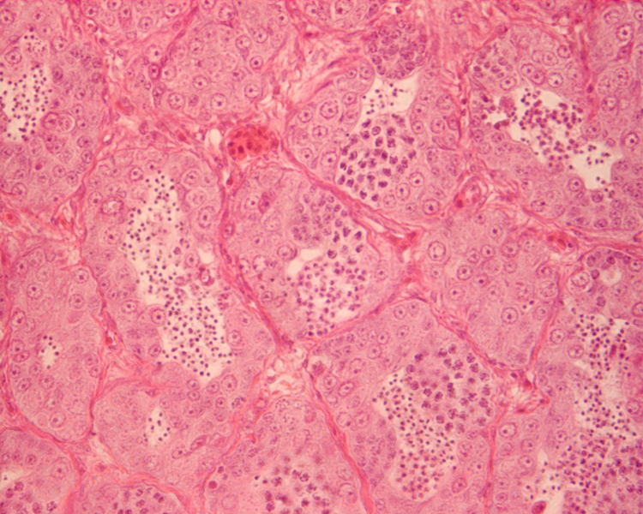

NC STATE UNIVERSITY
Southern Flounder Exhibit Temperature-Dependent Sex Determination
J. Adam Luckenbach*, John Godwin and Russell Borski
Department of Zoology, Box 7617, North Carolina State University, Raleigh, NC 27695
Introduction
Southern flounder (Paralichthys lethostigma) support valuable fisheries and show great promise for aquaculture. Female flounder are known to grow faster and reach larger adult sizes than males. Therefore, information on sex determination that might increase the ratio of female flounder is important for aquaculture.
Growth Does Not Differ by Sex
Temperature Affects Sex Determination
= male
50
80
= female
40
60
Body Weight (g)
30
40
Objective
This study was conducted to determine whether southern flounder exhibit temperature-dependent sex determination (TSD), and if growth is affected by rearing temperature.
% Females
**
20
20
0
31
6
28
23
31
6
10
18
23
28
***
Temperature (°C)
0
64
53
49
Results
Sex was discernible in most fish greater than 120 mm long.
High (28ºC) temperature produced 4% females.
Low (18ºC) temperature produced 22% females.
Mid-range (23ºC) temperature produced 44% females.
Fish raised at high or low temperatures showed reduced growth compared to those at the mid-range temperature.
Up to 245 days, no differences in growth existed between sexes.
Methods
Southern flounder broodstock were strip spawned to collect eggs and sperm for in vitro fertilization.
Hatched larvae were weaned from a natural diet (rotifers/Artemia) to high protein pelleted feed and fed until satiation at least twice daily.
Upon reaching a mean total length of 40 mm, the juvenile flounder were stocked at equal densities into one of three temperatures 18, 23, or 28°C for 245 days.
Gonads were preserved and later sectioned at 2-6 microns.
Sex-distinguishing markers were used to distinguish males (spermatogenesis) from females (oogenesis).
18
23
28
 
Temperature (°C)
(**P < 0.01 and ***P < 0.001 represent significant deviations from a 1:1 male:female sex ratio)
Rearing Temperature Affects Growth
80
Conclusions
These findings indicate that sex determination in southern flounder is temperature-sensitive and temperature has a profound effect on growth.
A mid-range rearing temperature (23°C) appears to maximize the number of females and promote better growth in young southern flounder.
Although adult females are known to grow larger than males, no difference in growth between sexes occurred in age-0 (< 1 year) southern flounder.
60
Histological Analysis
Body Weight (g)
 
40
20
0
37
51
37
Acknowledgements
The authors acknowledge the Salstonstall-Kennedy Program of the National Marine Fisheries Service and the University of North Carolina Sea Grant College Program for funding this research. Special thanks to Lea Ware and Beth Shimps for help with the work.
18
23
28
Male Differentiation
Female Differentiation
Temperature (ºC)

